Slide 1

Learning Objectives
LO1 Describe the different users of accounting information.
LO2 Prepare a net worth statement and explain its purpose.
Notes:
Page 6

Slide 2
What do you need for this class?
Lesson 1-1
LO1
Willingness to learn!
Pencil with good eraser and pen
Large Notecards / 3 Inch Binder
Set up Excel to run macros.
Open Excel. Click on Office Button, Excel Options, Trust Center, Trust Center Settings, Macro Settings. Click on the Enable All….. Close Excel.
Set up calculator shortcut on computer desktop
Notes:
Page 6

Slide 3
The Role of Accounting
Lesson 1-1
LO1
Data must be recorded and reported in accounting reports.
Then, the information can be provided to business owners, managers, investors, and others to make business decisions and measure performance.
Notes:
Page 6

Slide 4
What Is Accounting?
Lesson 1-1
LO1
Accounting is the process of planning, recording, analyzing, and interpreting financial information.
An accounting system is a planned process designed to compile financial data and summarize the results in accounting records and reports.
Financial reports that summarize the financial condition and operations of a business are called financial statements.
Notes:
Page 6

Slide 5
Accounting in Personal Life
Lesson 1-1
LO2
A net worth statement allows the person extending the loan to see the financial position of a borrower on a specific date and make a lending decision.
Anything of value that is owned is called an asset.
An amount owed is called a liability.
The difference between personal assets and personal liabilities is called personal net worth.
In business, net worth is also called equity.
Equity is the difference between assets and liabilities.
Notes:
Page 7

Slide 6
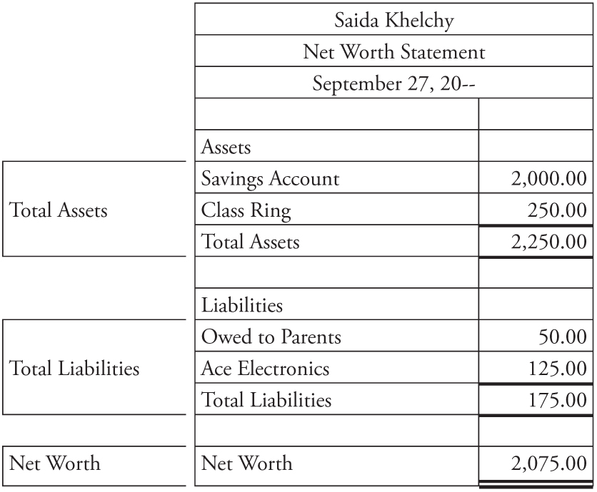
Personal Net Worth Statement
Lesson 1-1
LO2
1
2
3
Total Assets
(owned)
Total Liabilities
(owed)
3
−
=
Net Worth
(also known as Equity)
1
2
Notes:
Page 7

Slide 7
Ethics in Business
Lesson 1-1
LO2
The principles of right and wrong that guide an individual in making decisions are called ethics.
The use of ethics in making business decisions is called business ethics.
Notes:
Page 8

Slide 8

Lesson 1-1 Audit Your Understanding
Lesson 1-1
1. What is accounting?
ANSWER
Accounting is the process of planning, recording, analyzing, and interpreting financial information.
Notes:
Page 9

Slide 9
Lesson 1-1 Audit Your Understanding
Lesson 1-1
2. Why is accounting called the language of business?
ANSWER
Accounting provides financial information to everyone who needs it to make good business decisions.
Notes:
Page 9

Slide 10
Lesson 1-1 Audit Your Understanding
Lesson 1-1
3. Describe a scenario in which you, as a nonaccountant, might use accounting.
ANSWER
Answers may include creating a personal budget or providing information for a loan or credit card application.
Notes:
Page 9

Slide 11
Work Together 1-1 On You Own 1-1
Work Together
Modeled
On Your Own
Complete

Slide 12
Application Problems
1-1 Application Problem

Slide 13

Learning Objectives
LO3 Classify accounts as assets, liabilities, or owner’s equity and demonstrate their relationship in the accounting equation.
LO4 Analyze the effects of transactions on the accounting equation.
LO5 Distinguish between cash and on account transactions.
Notes:
Page 10

Slide 14
The Business—Delgado Web Services
Lesson 1-2
A business that performs an activity for a fee is called a service business.
A proprietorship is a business owned by one person.
A proprietorship is sometimes referred to as a sole proprietorship.
A business plan is a formal written document that describes the nature of a business and how it will operate.
Notes:
Page 10

Slide 15
Accounting Standards and Rules
Lesson 1-2
The standards and rules that accountants follow while recording and reporting financial activities are commonly referred to as generally accepted accounting principles or GAAP.
Notes:
Page 11

Slide 16
The Accounting Equation
Lesson 1-2
LO3
Financial rights to the assets of a business are called equities.
The amount remaining after the value of all liabilities is subtracted from the value of all assets is called owner’s equity.
The equation showing the relationship among assets, liabilities, and owner’s equity is called the accounting equation.
Notes:
Page 13

Slide 17

The Accounting Equation
Lesson 1-2
LO3
Use a large note card to make a graphic organizer
assets on one side
liabilities and owner’s equity on the other side
Notes:
Page 13

Slide 18
Accounting Note Card
Assets
Account name
Liabilities
Account name
Owner’s Equity
Account name

Slide 19
Accounting Equation Concept
Assets = Liabilities + Owner’s Equity
11,000
3,000
8,000
10,000
4,000
6,000
63,000
35,000
28,000

Slide 20
Accounting Equation Concept cont.
Assets = Liabilities + Owner’s Equity
30,000
17,000
13,000
80,000
60,000
20,000
51,000
25,000
26,000

Slide 21
Receiving Cash
Lesson 1-2
LO4
Accountants call any business activity that changes assets, liabilities, or owner’s equity a transaction.
A record that summarizes all the transactions pertaining to a single item in the accounting equation is called an account.
The name given to an account is called an account title.
The difference between the increases and decreases in an account is called the account balance.
An account used to summarize the owner’s equity in a business is called a capital account.
Notes:
Page 14

Slide 22
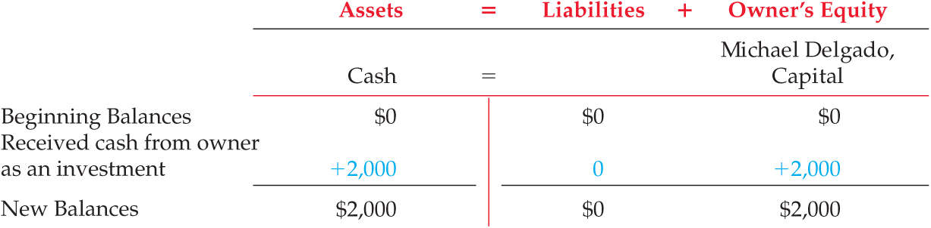
Receiving Cash
Lesson 1-2
LO4
Transaction 1 January 2. Received cash from owner as an investment, $2,000.00.
Transaction says “received cash” means cash increases
Write cash on asset side of card.
Write capital on owner’s equity side of card
capital account used to summarize the owner’s equity in a business
Verify that equation is balanced
Notes:
Page 14

Slide 23
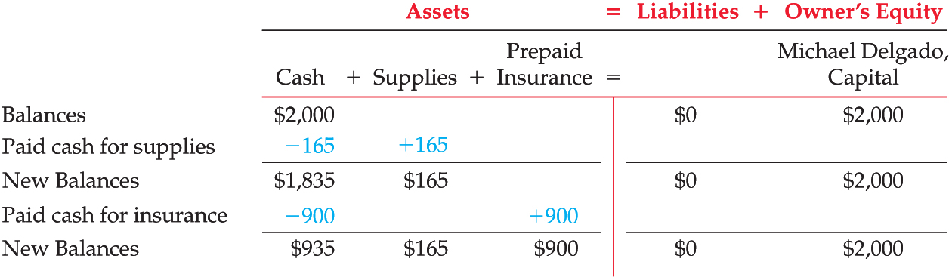
Paying Cash
Lesson 1-2
LO4
Transaction 2 January 2. Paid cash for supplies, $165.00.
Transaction 3 January 3. Paid cash for insurance, $900.00.
Transaction says “paid” means cash decreases
Write supplies and prepaid insurance on asset side of card
2 asset accounts can be affected in same transaction
Verify that equation is balanced
Notes:
Page 15

Slide 24
Transactions on Account
Lesson 1-2
LO5
A person or business to whom a liability is owed is called a creditor.
Notes:
Page 16

Slide 25
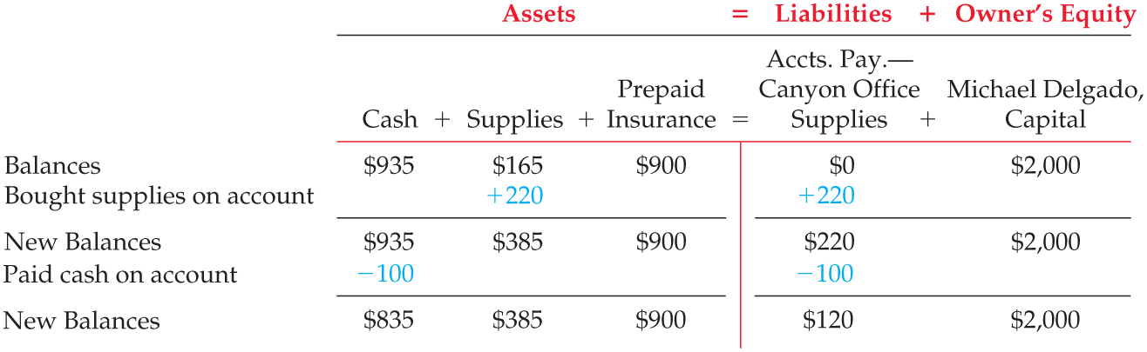
Transactions on Account
Lesson 1-2
LO5
Transaction 4 January 5. Bought supplies on account from Canyon Office Supplies, $220.00
Transaction 5 January 9. Paid cash on account to Canyon Office Supplies, $100.00.
Write accounts payable on liability side of card
Read transaction if increase on left side, increase on right
if decrease on left side, decrease on right
Verify that equation is balanced
Notes:
Page 16

Slide 26
Lesson 1-2 Audit Your Understanding
Lesson 1-2
1. Give two examples of service businesses in your area.
ANSWER
Answers should include businesses that perform activities for a fee, such as dry cleaners, car washes, or landscapers.
Notes:
Page 17

Slide 27
Lesson 1-2 Audit Your Understanding
Lesson 1-2
2. What must be done if a transaction increases the left side of the equation?
ANSWER
The right side must also be increased.
Notes:
Page 17

Slide 28
Lesson 1-2 Audit Your Understanding
Lesson 1-2
3. How can a transaction affect only one side of the equation?
ANSWER
If one account is increased, another account on the same side of the equation must be decreased by the same amount.
Notes:
Page 17

Slide 29
Lesson 1-2 Audit Your Understanding
Lesson 1-2
4. What does the term on account mean?
ANSWER
Purchasing on account means buying items or services and paying for them at a future date.
Notes:
Page 17

Slide 30
Analyzing Business Transactions
Carefully read the transaction
Identify the accounts involved
asset
liability
owner’s equity
How are the accounts affected?
increased or decreased?

Slide 31
1-2 work together Review in class
page 17
Write + if the account is increased, – if the account is decreased
Transaction Assets = Liabilities + Owner’s Equity
1. Bought supplies on account
+
+
2. Rec’d cash from owner as investment
+
+
-
+
3. Paid cash for insurance
-
-
4. Paid cash on account

Slide 32
1-2 on your own Review in class
page 17
Transaction Assets = Liabilities + Owner’s Equity
1. Rec’d cash from owner as investment
+
+
2. Bought supplies on account
+
+
3. Paid cash for supplies
-
+
-
+
4. Paid cash for insurance
5. Paid cash on account
-
-

Slide 33
Application Problems
1-2 Application Problem

Slide 34

Learning Objectives
LO6 Compare and contrast the types of transactions that increase and decrease owner’s equity.
LO7 Explain the difference between expenses and liabilities.
Notes:
Page 18

Slide 35
Transactions Affecting Owner’s Equity
Lesson 1-3
LO6
An increase in equity resulting from the sale of goods or services is called revenue.
A sale for which payment will be received at a later date is called a sale on account.

Slide 36
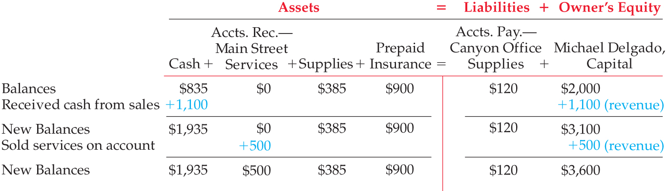
Transactions Affecting Owner’s Equity
Lesson 1-3
LO6
Transaction 6 January 10. Received cash from sales, $1,100.00.
Transaction 7 January 12. Sold services on account to Main Street Services, $500.00.
Write accounts receivable on asset side of card

Slide 37
Transactions Affecting Owner’s Equity
Lesson 1-3
LO6
Total of left side:
$1,935 + $500 + $385 + $900 =
$3,720
Total of right side:
$120 + $3,600 =
$3,720

Slide 38
Expense Transactions
Lesson 1-3
LO7
Unlike a liability, which is an amount that is owed, the cost of goods or services used to operate a business is called an expense.

Slide 39
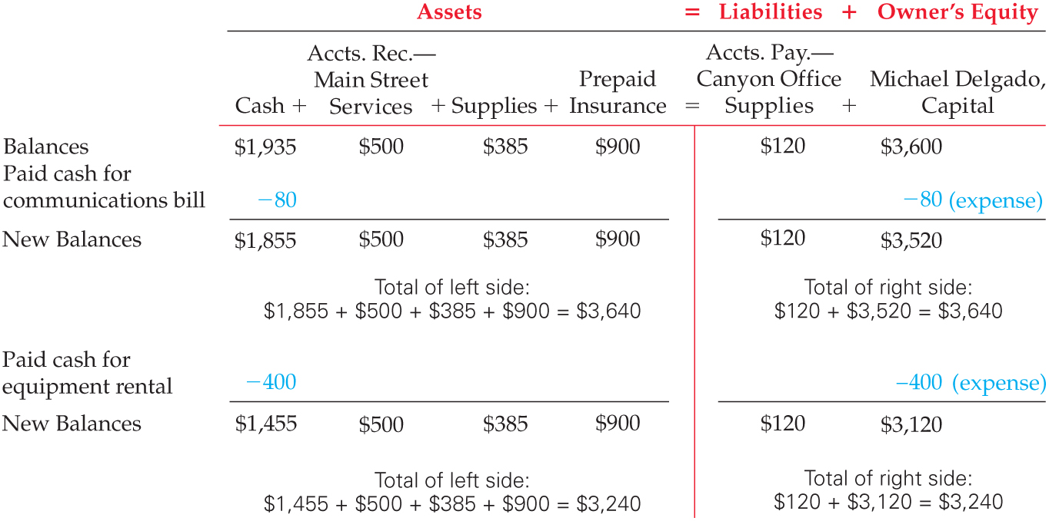
Expense Transactions
Lesson 1-3
LO7
Transaction 8 January 12. Paid cash for communications bill for cell phone and Internet service, $80.00.

Slide 40
Expense Transactions
Lesson 1-3
LO7
Transaction 9 January 13. Paid cash for equipment rental, $400.00.

Slide 41
Other Cash Transactions
Lesson 1-3
Assets taken from the business for the owner’s personal use are called withdrawals.

Slide 42
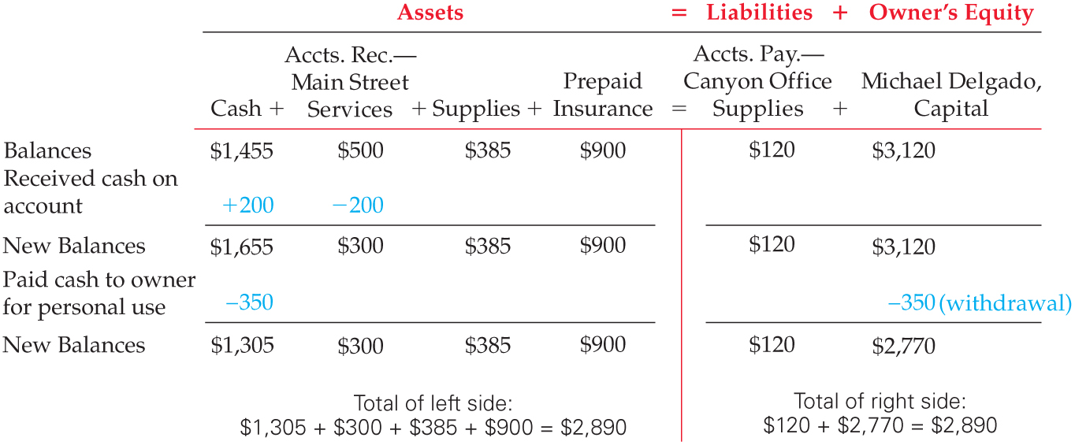
Other Cash Transactions
Lesson 1-3
Transaction 10 January 16. Received cash on account from Main Street Services, $200.00.
Transaction 11 January 16. Michael Delgado withdrew equity in the form of cash, $350.00.

Slide 43
Summary of Changes in Owner’s Equity
Lesson 1-3
Transaction Number | Kind of Transaction | Change in Owner’s Equity
6 | Revenue (cash) | +1,100.00
7 | Revenue (on account) | +500.00
8 | Expense (communications) | –80.00
9 | Expense (equipment rental) | –400.00
11 | Withdrawal of equity | –350.00
Net change in owner’s equity |  | +770.00

Slide 44
Lesson 1-3 Audit Your Understanding
Lesson 1-3
1. How is owner’s equity affected when cash is received from sales?
ANSWER
Owner’s equity is increased.

Slide 45
Lesson 1-3 Audit Your Understanding
Lesson 1-3
2. How is owner’s equity affected when services are sold on account?
ANSWER
Owner’s equity is increased.

Slide 46
Lesson 1-3 Audit Your Understanding
Lesson 1-3
3. How is owner’s equity affected when cash is paid for expenses?
ANSWER
Owner’s equity is decreased.

Slide 47
work together 1-3 Open 1-3 spreadsheet, work 1-3 tab
page 22
work together 1-3
p 22
Place a plus (+) in the column if account increased, a minus (-) if the account decreased.
 | Assets |  |  |  |  |  |  |  |  |  | = | Liabilties |  |  | Owner's Equity
Transaction | Cash | + |  | Accts. Rec. Harmon Co. | + |  | Supplies | + |  | Prepaid Insurance | = | Accounts Payable Corona Supplies | + |  | Nate Conrad, Capital
1. Received cash from sales
2. Sold services on account to Harmon Company
3. Paid cash for cell phone bill.
4. Received cash on account from Harmon Company.
5. Paid cash to owner for personal use.
+
+
+
+
-
-
+
-
-
-

Slide 48
on your own 1-3 Open 1-3 spreadsheet, own 1-3 tab
page 22
on your own 1-3
p 22
Place a plus (+) in the column if account increased, a minus (-) if the account decreased.
 | Assets |  |  |  |  |  |  |  |  |  | = | Liabilties |  |  | Owner's Equity
Transaction | Cash | + |  | Accts. Rec. Bethany Ctr | + |  | Supplies | + |  | Prepaid Insurance | = | Accounts Payable McGrew Supplies | + |  | Bryan Arnett, Capital
1. Sold services on account to Bethany Center.
2. Received cash from sales.
3. Received cash on account from Bethany Center.
4. Owner withdrew equity in the form of cash.
5. Paid cash for rent.
Check answers in class. DO NOT print.
+
+
+
+
+
-
-
-
-
-

Slide 49
Application Problems
1-3 Application Problem
Reference the file
Do not need book for problem
1-4 Application Problem

Slide 50
Analyzing Nike’s financial statements
Page 29
Intro to Financial Statements (Word)
Complete Exercise together in class
Complete Research on-line

Slide 51
Unit 1 Assessment
Unit 1 Review (ExamView)
90 % or Greater
5 Point Bonus on Unit 1 Concept Quiz (20% Bonus)
Unit 1 Part 1 Quiz (ExamView)
Concepts – 25 Questions (25 Points)
Unit 1 Part 2 Quiz (Excel)
Skills (25 Points)

